Slide 2
Install Bootstrap Using LibMan
Right click on the "Project Name" in Solution Explorer and Select Add > Client-Side Library. In the "Add Client-Side Library" window that opens
Leave the default provider which is cdnjs
In the "Library" text box, type "twitter-bootstrap". Upon selecting the matching entry, it tries to install the latest version. However, you can manually type the version you want. You also have intellisense support. We will install the lates Bootstrap version 4.
You can either include "All the library file" or "Just the files you need"
In the "Target Location" text box specify the folder where you want the library files to be copied. Recollect, by default static files are only served from WWWRoot folder.
Click the "Install" Button

Slide 3
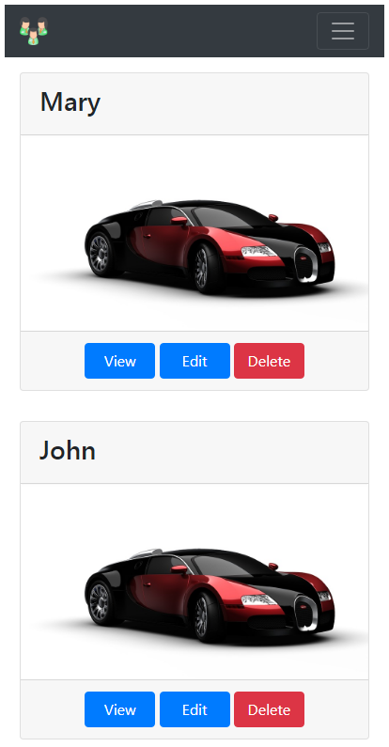
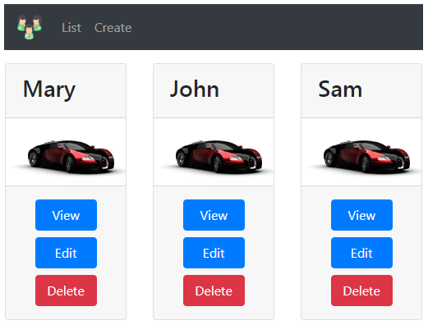
creating a responsive navigation menu in asp.net core application using Bootstrap 4.
On a large screen device the navigation menu should look as shown below.
On a small screen device the navigation menu should look as shown below.

Slide 4
Bootstarp 4 has a dependency on jQuery. So please download and install jQuery in your asp.net core application. You can use the Library Manager tool to do this.
Layout.cshtml Code
<html><head>
<meta name="viewport" content="width=device-width" />
<environment include="Development">
<link href="~/lib/bootstrap/css/bootstrap.css" rel="stylesheet" />
<script src="~/lib/jquery/jquery.js"></script>
<script src="~/lib/bootstrap/js/bootstrap.js"></script>
</environment>
<environment exclude="Development">
<link rel="stylesheet" href="https://stackpath.bootstrapcdn.com/bootstrap/4.3.1/css/bootstrap.min.css"
integrity="sha384-ggOyR0iXCbMQv3Xipma34MD+dH/1fQ784/j6cY/iJTQUOhcWr7x9JvoRxT2MZw1T" crossorigin="anonymous"
asp-fallback-href="~/lib/bootstrap/css/bootstrap.min.css"
asp-fallback-test-class="sr-only" asp-fallback-test-property="position" asp-fallback-test-value="absolute"
asp-suppress-fallback-integrity="true" />
</environment>
<link href="~/css/site.css" rel="stylesheet" />
<title>@ViewBag.Title</title>
</head>
<body>
<div class="container">
<nav class="navbar navbar-expand-sm bg-dark navbar-dark">
<a class="navbar-brand" asp-controller="home" asp-action="index">
<img src="~/images/employees.png" width="30" height="30">
</a>
<button class="navbar-toggler" type="button" data-toggle="collapse" data-target="#collapsibleNavbar">
<span class="navbar-toggler-icon"></span>
</button>
<div class="collapse navbar-collapse" id="collapsibleNavbar">
<ul class="navbar-nav">
<li class="nav-item">
<a class="nav-link" asp-controller="home" asp-action="index">List</a>
</li>
<li class="nav-item">
<a class="nav-link" asp-controller="home" asp-action="create">Create</a>
</li>
</ul>
</div>
</nav>
<div> @RenderBody() </div>
@if (IsSectionDefined("Scripts"))
{ @RenderSection("Scripts", required: false) }
</div></body></html>

Slide 5
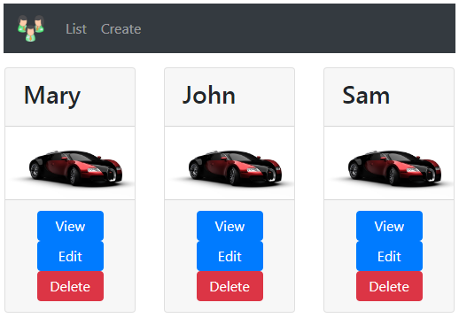
On a small screen device, for the navbar toggle button to work, jQuery must be loaded before Bootstrap JavaScript file. If you flip the order, the navbar toggle button does not work.
<environment include="Development">
<link href="~/lib/bootstrap/css/bootstrap.css" rel="stylesheet" />
<script src="~/lib/jquery/jquery.js"></script>
<script src="~/lib/bootstrap/js/bootstrap.js"></script>
</environment>
Please note : For a non-development environment (i.e Staging, Production etc), I have not included the required <link> tags to load jQuery and Bootstrap JavaScript from a CDN. I am leaving that as an exercise for you to do.
Notice how the buttons (View, Edit & Delete) are attached to each other. To include margin between these button use the Bootstrap margin classes (m-1, m-2 etc). In the class name, "m" stands for margin and the number 1,2 etc is the size of the space you want.
In index.chtml modify the <a> tags to include "m-1" bootstrap class
<div class="card-footer text-center">
<a asp-controller="home" asp-action="details"
asp-route-id="@employee.Id" class="btn btn-primary m-1">View</a>
<a href="#" class="btn btn-primary m-1">Edit</a>
<a href="#" class="btn btn-danger m-1">Delete</a>
</div>

